Slide 1
Lesson objective
PBiS focus
Achieve – give it a try
Learn – complete tasks
Title: Balancing equations
Aim:
Perform sums that balance equations
Be able to solve equations using a variety of strategies
Plan:
Review solving by inspection
Inverse solving practice
Balancing equation
Need whiteboards and calculators

Slide 2
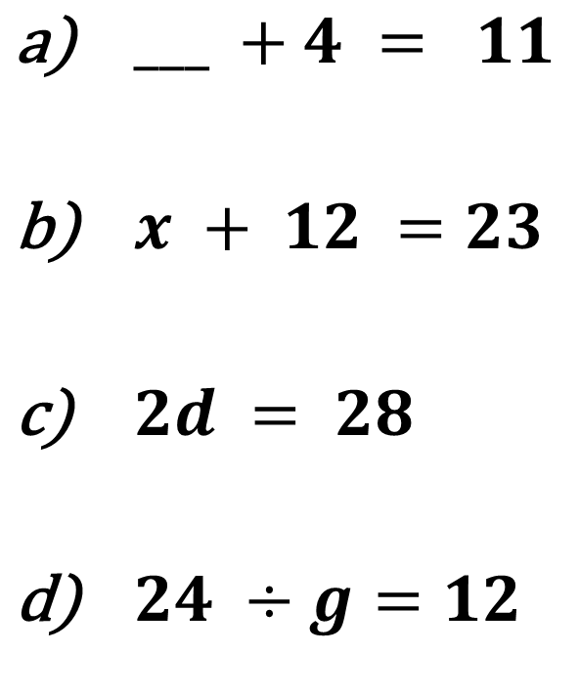
Solving through inspection
$___ +4 = 11$
$x + 12 =23$
$2d = 28$
$24 ÷g=12$

Slide 3
Questions
Work out the value of n:
Green
8 + n = 11
6 + n = 15
n – 12 = 3
n – 14 = 4
Amber
n – 12 = 9
n – 6 = 7
3n = 24
9n = 54
Red
7n = 56
12n = 72
13n = 169
n ÷ 7 = 9
n ÷ 12 = 3
n ÷ 9 = 12

Slide 4
Answers
Green
n = 3
n = 9
n = 15
n = 18
Amber
n = 21
n = 13
n = 8
n = 6
Red
n = 8
n = 6
n = 13
n = 63
n = 36
n = 108

Slide 5

Daily review – copy with me
4x + 12 = 24
30 = 9 + 7y
$\frac{x}{7}+8=11$

Slide 6

Whiteboards – you do
2x + 5 = 11
18 = 8f +2
$\frac{h}{5}−6=3$

Slide 7
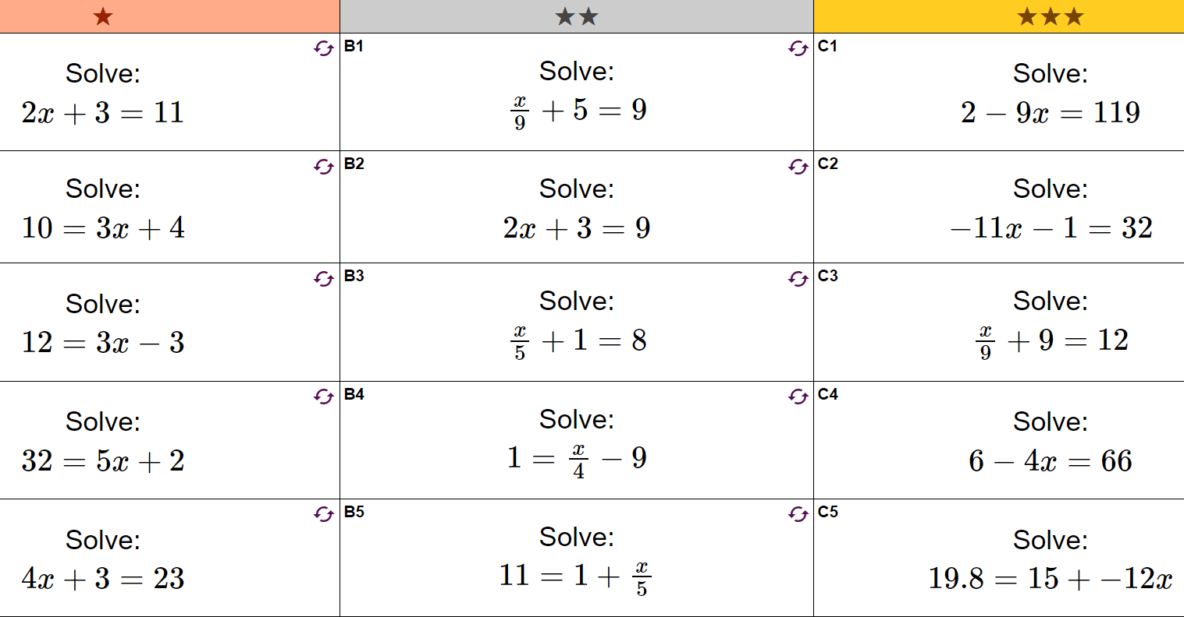

Slide 8
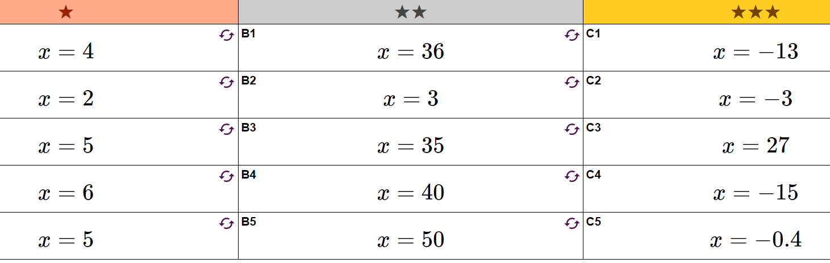

Slide 9
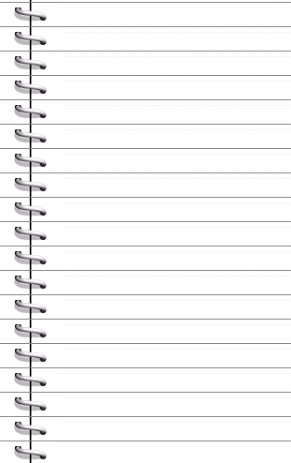
Equations – Keep it balanced…
x + 3 = 5
x
+
3
=
5
Take off 3
x = 2
1
x
1
1
1
1
1
1
1

Slide 10
Equations – Keep it balanced…
2x + 1 = 3
2
x
+
1
=
3
Take off 1
2x = 2
Half both sides
x = 1
x
x
1
1
1
1

Slide 11
Equations – Keep it balanced…
3x + 2 = 8
3
x
+
2
=
8
Take off 2
3x = 6
divide both sides by 3
x
1
1
x = 2
x
x
1
1
1
1
1
1
1
1

Slide 12
I do
5x + 11 = 26
4y + 7 = 19
7c + 3 = 38

Slide 13
We do
11x + 3 = 25
5y + 10 = 25
25 + 3x = 34

Slide 14

Solving Equations
YOU DO…..in your books…
4
x
+
10
=
18
2
x
+
9
=
19
x
+
22
=
50
3
x
+
4
=
19
3
x
+
4
=
1

Slide 15
Solving Equations
What if…
4
x
10
=
18
?
-
4x - 10 = 18
Add on 10
4x = 28
divide both sides by 4
x = 7

Slide 16
Solving Equations
In your books…
2
x
12
=
18
-
2
x
9
=
7
-
x
8
=
10
-
3
x
4
=
17
-
4
x
4
=
-12
-

Slide 17
Individual practice
Activity sheet (DG)

